Slide 1

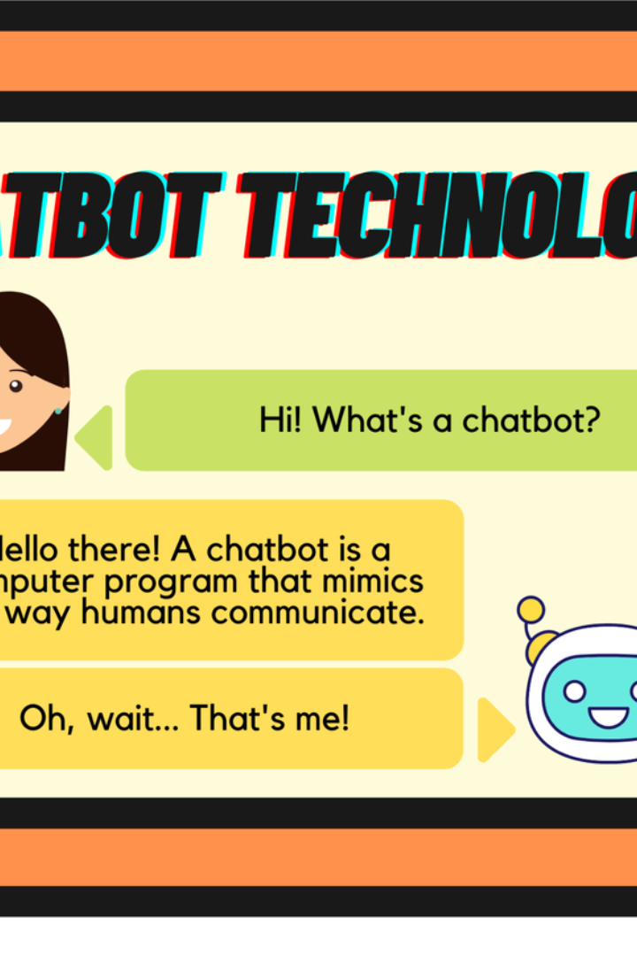


Introduction to Chatbots
Chatbots are computer programs designed to simulate conversation with human users. They are used in a wide range of applications, including customer service, information retrieval, and now, in the field of education and learning.
by Masoud Shahabian

Slide 2

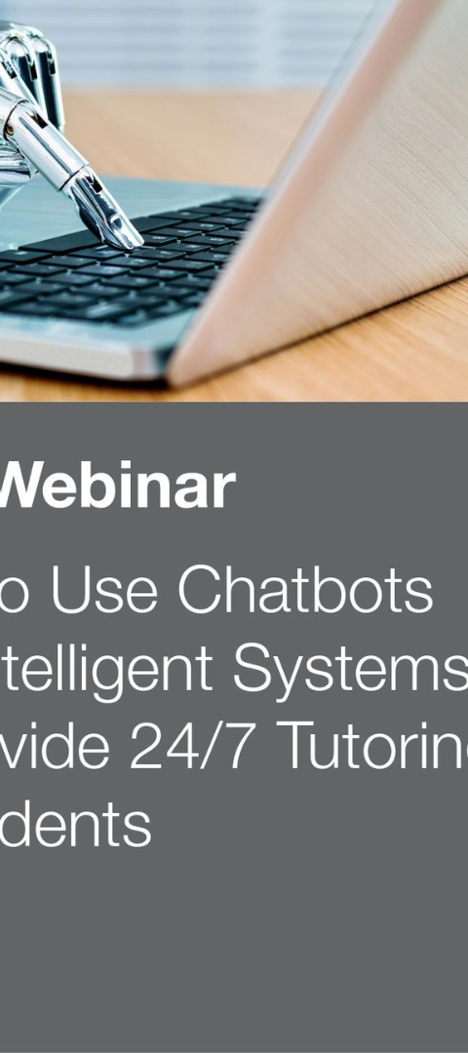
Benefits of Using Chatbots in Education and Learning
1
24/7 Availability
2
Personalized Assistance
Chatbots can provide instant support to students, enhancing accessibility and flexibility in learning.
They offer personalized learning experiences by catering to individual needs, progress tracking, and customized teaching methods.
3
Interactive Learning
Chatbots engage students in interactive conversations, quizzes, and games, making learning more engaging and enjoyable.

Slide 3
Examples of Chatbot Applications in Education
Language Learning
Chatbots are used to practice language skills through conversation and exercises.
Virtual Tutoring
Students use chatbots for one-on-one tutoring and homework assistance.
Administrative Support
Chatbots handle administrative tasks like enrollment, scheduling, and FAQs.

Slide 4

Enhancing Student Engagement with Chatbots
Adaptive Learning
Instant Feedback
Chatbots adapt to the student's learning speed, style, and preferences, keeping them engaged.
They provide immediate feedback on quizzes and assignments, keeping students motivated and informed.
Interactive Activities
Students can participate in interactive learning games and simulations offered by chatbots.

Slide 5




Personalized Learning Experiences with Chatbots
Assessment
Chatbots assess individual strengths and weaknesses to tailor learning materials effectively.
Adaptation
They adapt teaching methods and content to match the student's pace and comprehension level.
Progress Tracking
Chatbots monitor student progress and provide targeted interventions and additional resources as required.

Slide 6
Chatbots for Assessment and Feedback
Quizzes and Tests
Feedback Mechanism
Promptly conduct quizzes and tests to evaluate student performance and provide instant results.
Chatbots offer constructive and personalized feedback on student work, driving improvement.

Slide 7
Challenges and Considerations in Implementing Chatbots in Education
1
Data Privacy
2
Quality Assurance
Ensuring student data privacy and protection is a critical concern when implementing chatbots.
Ensuring the accuracy and efficiency of chatbot responses in educational settings.
3
User Acceptance
Student and faculty acceptance of chatbot technology in the learning environment.

Slide 8
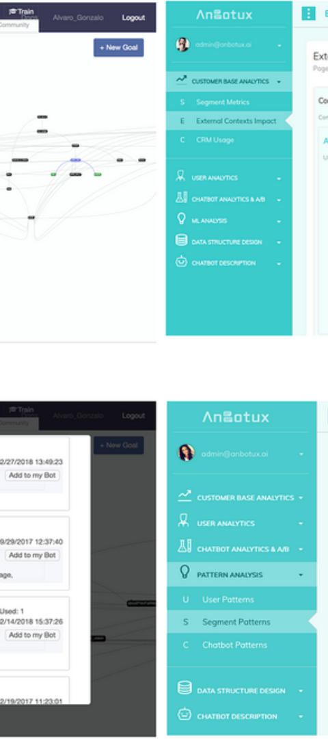
Conclusion and Key Takeaways
1
Interactive Learning Experience
Chatbots enhance the overall learning experience by providing interactive, personalized, and flexible support.
2
Data-Driven Insights
Implementing chatbots offers the opportunity to gather valuable insights for improvement and innovation in education.
3
Evolving Landscape
Chatbots signify the advancement of educational technology, revolutionizing the way students and teachers interact with information.

